Slide 1

EIE 2001 Basic Circuit Theory
Lecture 4
Operational Amplifier

Slide 2
Overview
Operational amplifier
  Basic structure
  Equivalent circuit
  Voltage saturation
  Ideal Op-amp
Op-Amp application examples
  Inverting amplifier
  Noninverting amplifier
  Difference amplifier
  Cascaded op-amps

Slide 3
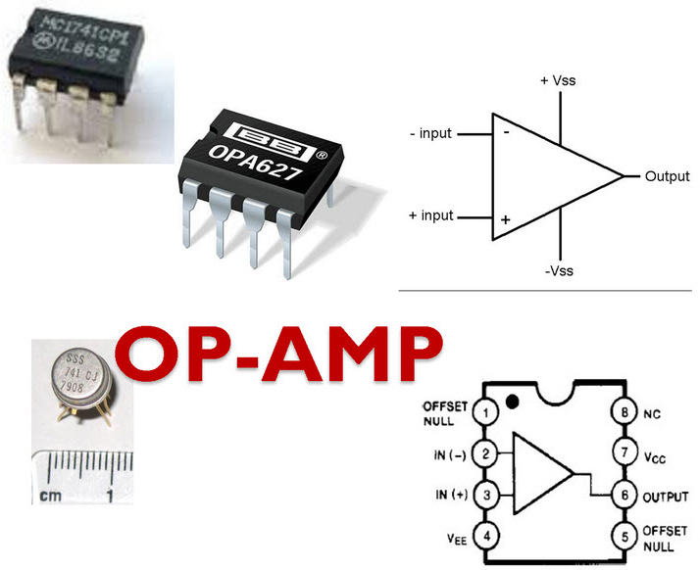
Operational Amplifier
The operational amplifier (Op-Amp for short) is a basic building block used in analog circuits.
Functions: In combination with other elements it can perform various functions:
  amplification/scaling
  sign changing
  Arithmetic operations (+ - × ÷)
  integration/differentiation
  analog filtering

Slide 4
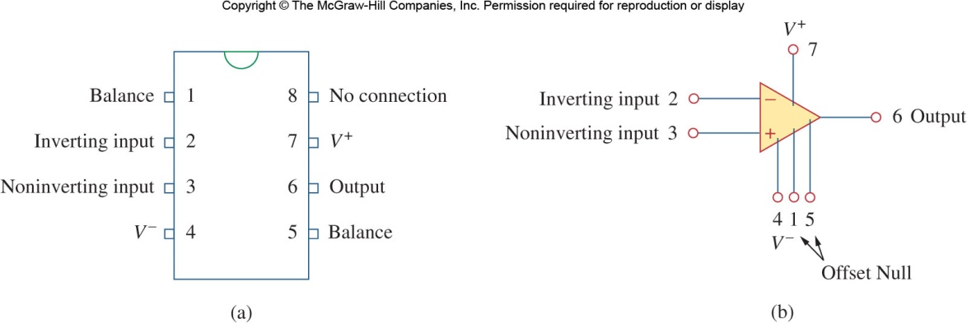
Pins of a Typical Operational Amplifier
There are five terminals found on all op-amps
  The inverting input
  The non-inverting input
  The output
  The positive power supply
  The negative power supply
The other three terminals
  1,5: offset null (balance)
  8: no connection (NC)
Notes:
The functionality of the offset pins may vary in devices. For example, it may be used to balance the input current.
In practice, you should read the manual of the IC.

Slide 5
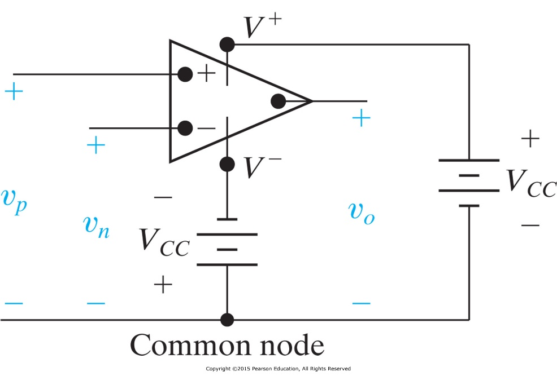
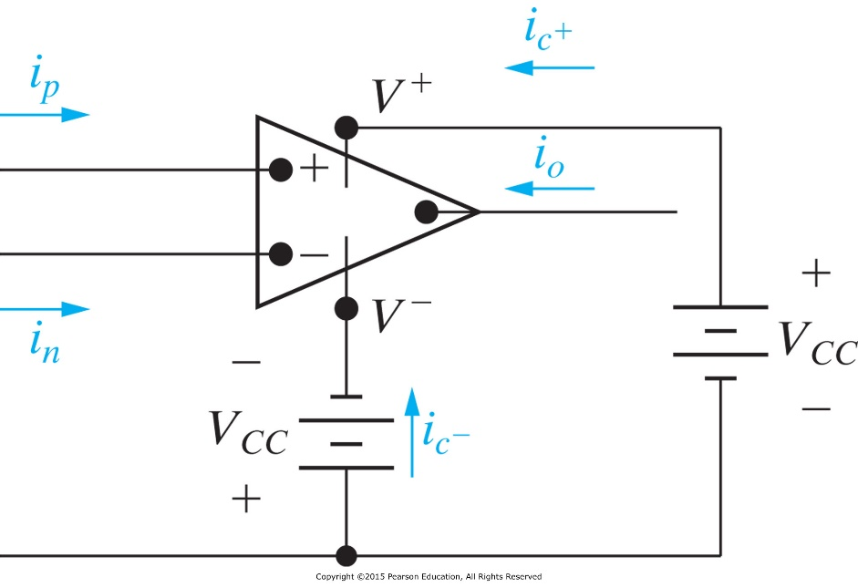
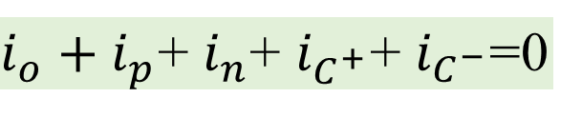
Powering an Op-amp
Most op-amps use two voltage sources, with a ground reference between them; this gives a positive and negative supply voltage
Sometimes in circuit diagrams the power supply terminals are obscured, or say that it is taken for granted that they must be connected
Op-amp is an active element.
$i_{o}+i_{p}$+ $i_{n}$+ $i_{C^{+}}$+ $i_{C^{−}}$=0
Notes:
It is an active element because it is usually taken for granted that it is connected with voltage/current sources.

Slide 6
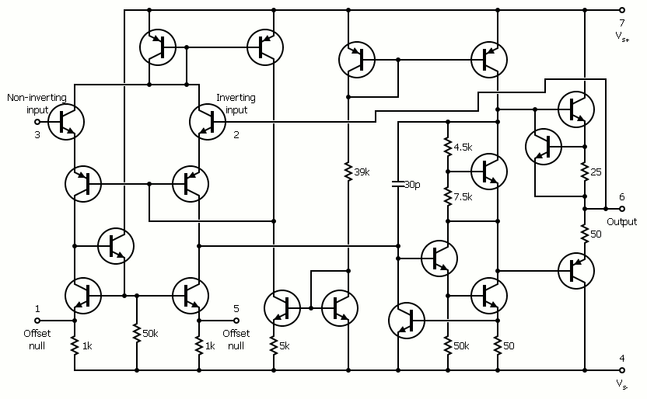
Internal circuit of a 741 op-amp
A BJT (Bipolar Junction Transistor) op amp first made in 1968 by Fairchild Semiconductor

Slide 7
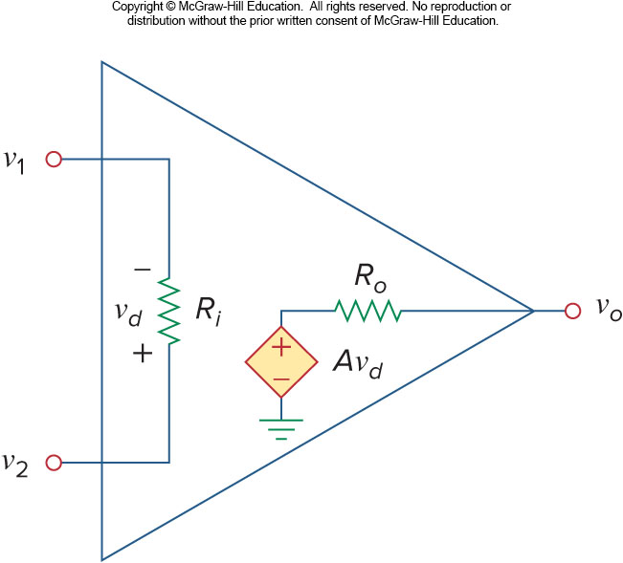
Op-amp is a (linear) dependent source
An op-amp can be modelled as a dependent source as shown on the right.
The open-circuit voltage output of an op-amp is proportional to the difference between the non-inverting and inverting inputs.
Here, A is called the open loop gain.
However, saturation will occur if v_{o} exceeds the power supply voltage. (Op-amp is no longer linear when it saturates.)
Equivalent circuit of a nonideal op-amp
Inverting terminal
v₁
v_{o}
(linear)
v₂
Non-inverting terminal
Notes:
An intuitive explanation of saturation: the output voltage cannot go beyond the voltage of the power supply.

Slide 8
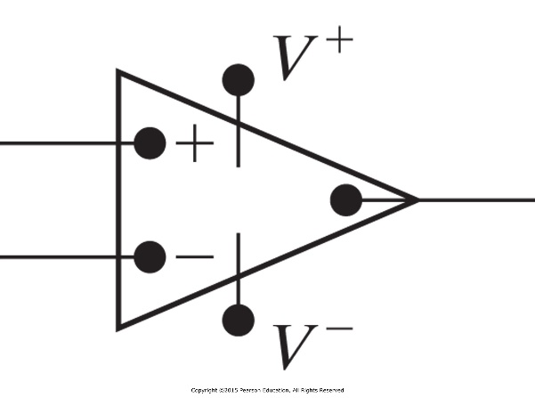
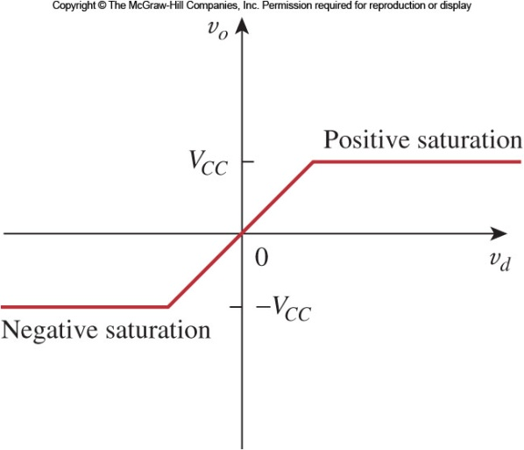
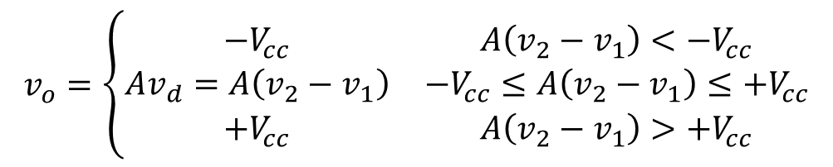
Voltage Saturation
The terminal behavior of the op amp is a linear circuit element. However, the output is constrained not to exceed the supply voltages (V_{cc}).
When an output should exceed the possible voltage range, the output remains at either the maximum or minimum supply voltage, this is called Voltage Saturation.
Outputs between these limiting voltages are referred to as the linear region.
$$v_{o}=\left\{\begin{matrix}−V_{cc} & {A\left(v_{2}−v_{1}\right)<−V}_{cc} \\ Av_{d}=A\left(v_{2}−v_{1}\right) & −V_{cc}≤A\left(v_{2}−v_{1}\right)≤+V_{cc} \\ +V_{cc} & {A\left(v_{2}−v_{1}\right)>+V}_{cc}\end{matrix}\right.$$
Notes:
Note that there is a linear region and a saturation region for op-amp.

Slide 9
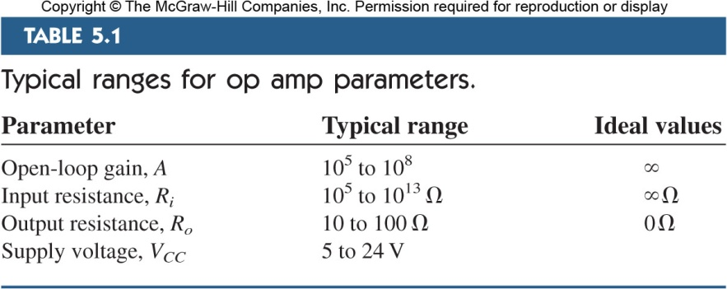
Typical Range for Op-Amp Parameters
For the loop gain, A, ideally it is infinite.
In real devices, it is still high: 10⁵ to 10⁸
Equivalent circuit of a non-ideal op-amp
Notes:
The fact that we prefer infinite open loop gain and infinite input resistance is to ”isolate” the op-amp from the external environment, i.e., we don’t want the op-amp circuit affect the external environment.

Slide 10
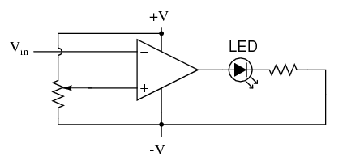

Circuits with Op-Amps: Comparator
V_{in}
V_{out}
R₂
R₁
The potentiometer R₁ is used to set a reference voltage.
If the input voltage V_{in} drops below the V_{ref}, the output will saturate to +V; then the LED will be powered.
This circuit can be used as a “low” alarm, e.g. to monitor if a device output maintain above certain threshold.

Slide 11
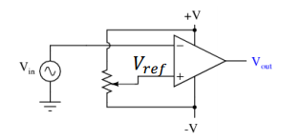
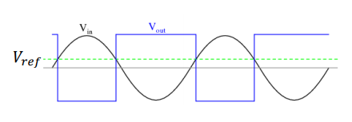
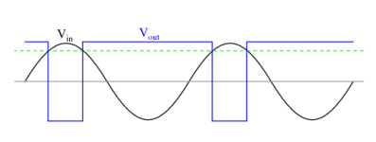

Comparator with sinusoid inputs
For the circuit on the left, what would be the output?
What if adjust the V_{ref} higher?
V_{in}
V_{out}
Application of this circuit: Useful for creating square waves of varying duty cycle (on/off time); Also referred to as pulse-width modulation (PWM)
Notes:
Useful for creating square waves of varying duty cycle (on/off time)
Referred to as pulse-width modulation (PWM)

Slide 12
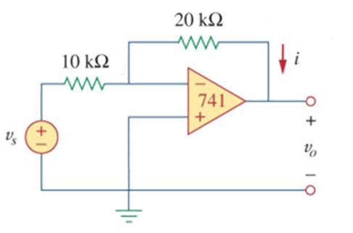
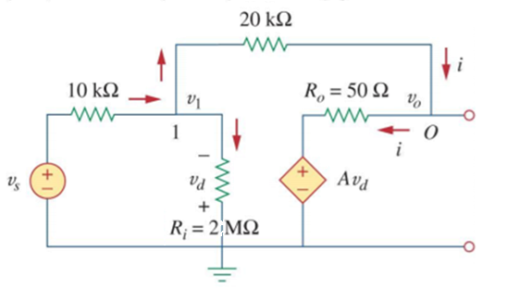




Consequence of the high input resistance and the high gain for Op-Amps: What can you observe?
A 741 op amp has an open-loop gain of 2 × 10⁵ , input resistance of 2𝑀Ω, and output resistance of 50Ω. Find the closed-loop gain 𝑣_{𝑜}/𝑣_{𝑠} . Determine current 𝑖 when 𝑣_{𝑠} = 2V.
20.066667μV
A
A
B
B
-3.9999398V
Apply KCL at Node A and B
$$i=−0.19999599\text{mA}$$
Notes:
Question: Can we apply Thevenin theorem here to simplify the circuit?

Slide 13
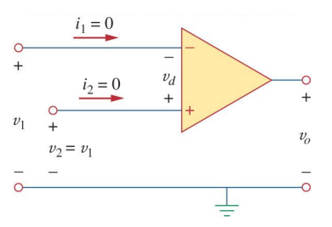
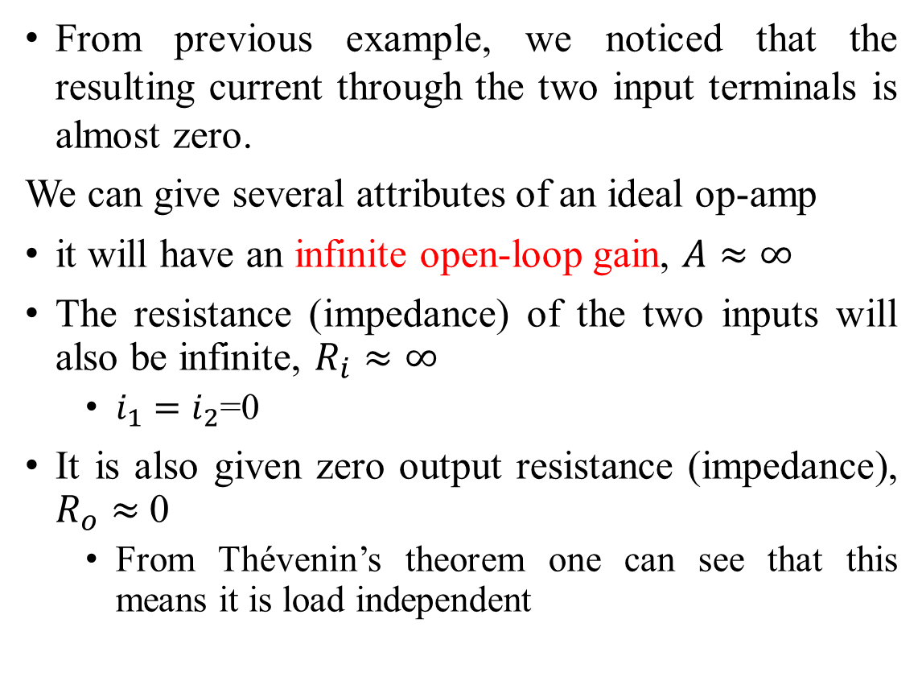
Practical Op-Amps may be approximated by ideal ones with …
From previous example, we noticed that the resulting current through the two input terminals is almost zero.
We can give several attributes of an ideal op-amp
it will have an infinite open-loop gain, $A≈∞$
The resistance (impedance) of the two inputs will also be infinite, $R_{i}≈∞$
  $i_{1}=i_{2}$=0
It is also given zero output resistance (impedance), $R_{o}≈$0
  From Thévenin’s theorem one can see that this means it is load independent

Slide 14
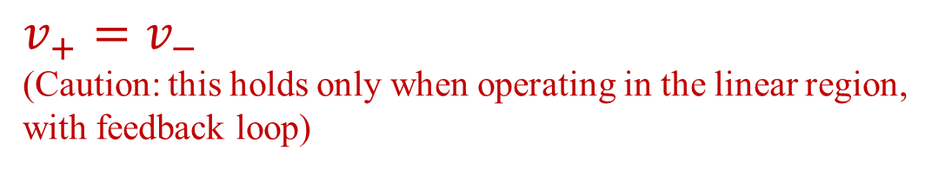

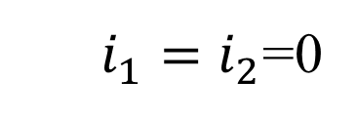


Ideal Op-Amp
Many modern op-amp come close to the ideal values:
  Most have very large open-loop gains, greater than one million.
  Input impedances are often in the Giga-Ohm to Terra-Ohm range, this means that current into both input terminals are zero.
Things to know about Op-Amp
  The equivalent circuit for nonideal Op-Amp
  For ideal Op-Amp, we have
$$A≈∞$$
$$R_{i}≈∞$$
  $i_{1}=i_{2}$=0
$$R_{o}≈0$$
$v_{+}=v_{−}$
(Caution: this holds only when operating in the linear region, with feedback loop)

Slide 15
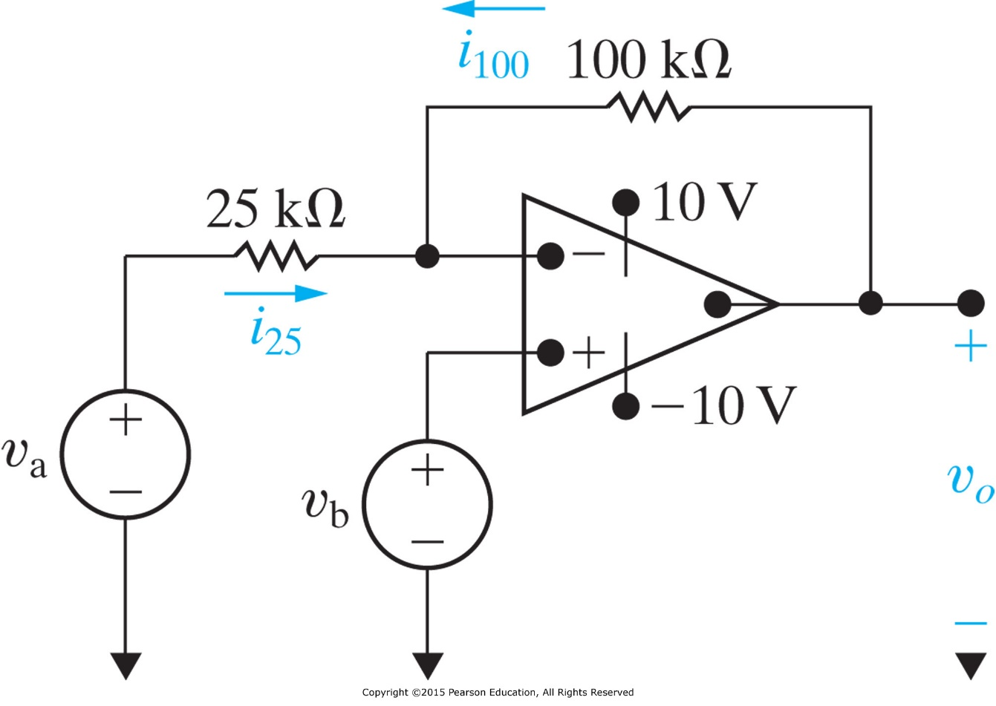
Example
Start with assuming linear operation region
(later checking this assumption against the result).
For an ideal op-amp as shown below,
(a) Calculate v₀ if v_{a} =1V and v_{b}=0V (b) Repeat (a) for v_{a}=1V and v_{b}=2V
(c) If v_{a} =1.5V, specify the range of v_{b} that avoids amplifier saturation

Slide 16
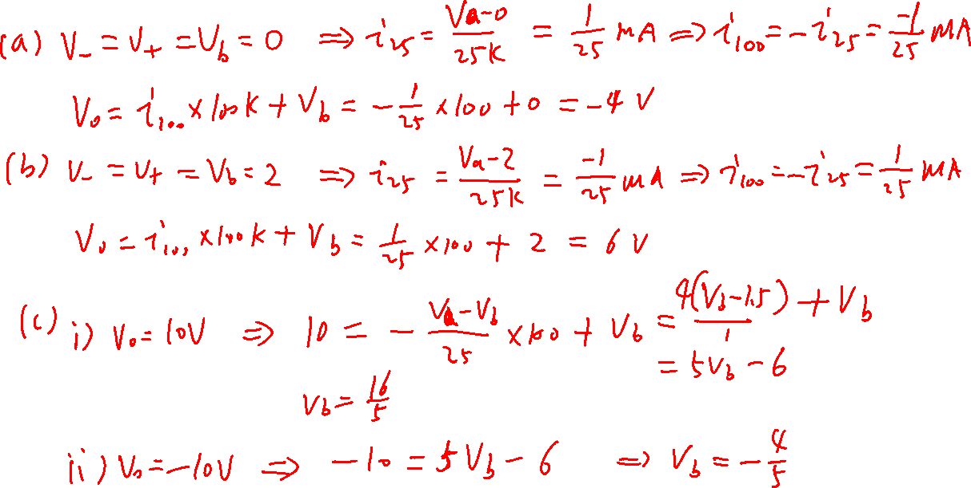

Slide 17
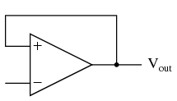
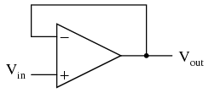
Op-Amp Circuits with Feedbacks
Op-amps take on an expanded functional ability with the use of feedback. Depending on what elements this signal passes through the gain and behavior of the op-amp changes.
The idea is that the output of the op-amp is fed back into the inverting/noninverting terminal.
  Feedback to the inverting terminal is called “negative feedback”
  Feedback to the non-inverting terminal is called “positive feedback”
Notes:
Question: Is Vin = Vout? Is the op-amp operating at its linear region?

Slide 18
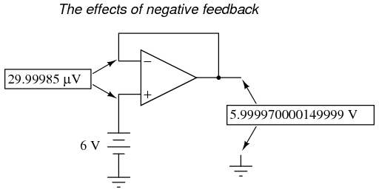
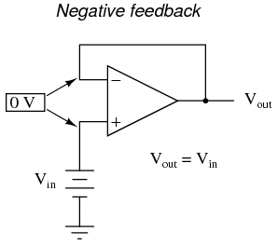
Negative feedback creates a condition of equilibrium
Example: A voltage follower by a negative feedback circuit with op-amp
then the output will increases, and vice versa, until “balance”
If there is an output voltage drop by delta

Slide 19
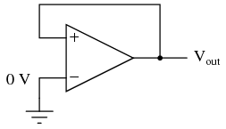
Positive feedback tends to lock the output at the boundaries
Example: A voltage follower by a positive feedback circuit with op-amp
For example, if our circuit is saturated at an output voltage of +12 volts (the power supply), it will take an input voltage at the inverting input of at least +12 volts to get the output to change. When it changes, it will saturate fully negative.

Slide 20
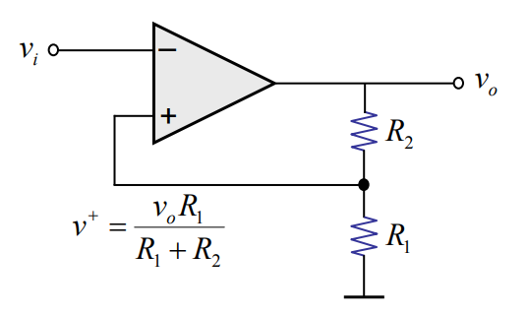
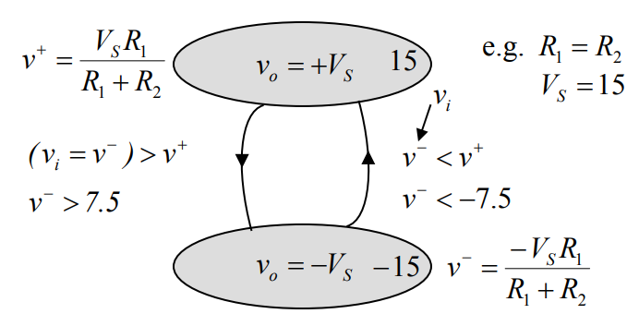
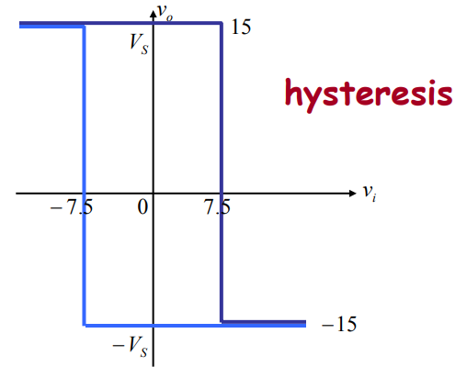

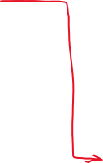
A positive feedback circuit: There are only two states of the output, which is triggered by two thresholds

Slide 21
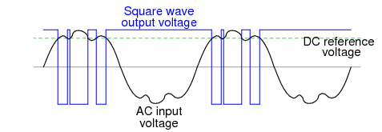
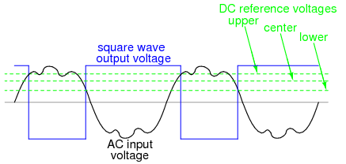
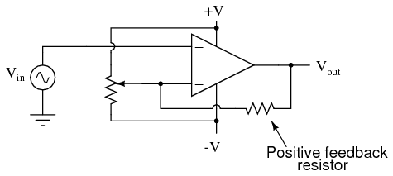
Application of the “latch” circuit: lock the output in a stable state
Positive feedback creates a condition of hysteresis (the tendency to “latch” in one of two extreme states).
Recall the (open loop) comparator:
Noise sensitive because any time there is a transition through the reference voltage level, no matter how tiny that transition may be, the output of the comparator will switch states, producing a square wave with “glitches.”
If we add positive feedback:

Slide 22
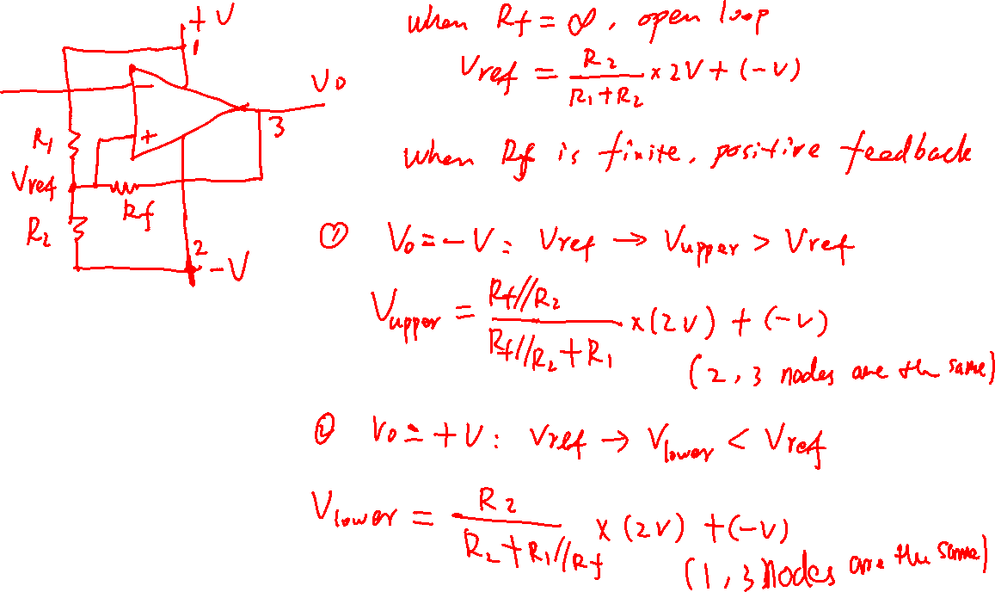


Slide 23
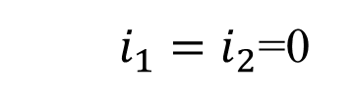

Negative feedback op-amp circuit
Negative feedback creates a condition of equilibrium (balance).
It enables the op-amp to possibly operate in its linear region.
Recall that
Usually, with negative feedback, the op-amp circuit can be used to amplify input signals.
  $i_{1}=i_{2}$=0
$$v_{+}=v_{−}$$

Slide 24
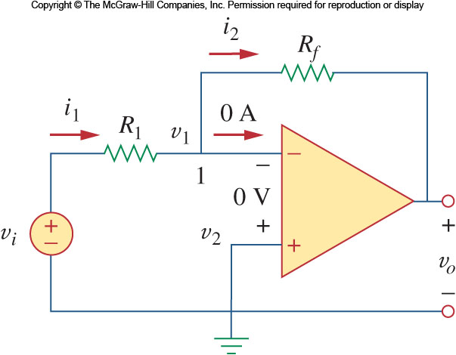
The Inverting Amplifier Circuit
The first useful op-amp circuit that we will consider is the inverting amplifier
Here the noninverting input is grounded.
The inverting terminal is connected to the output via a feedback resistor, R_{f}
The input is also connected to the inverting terminal via another resistor, R₁

Slide 25
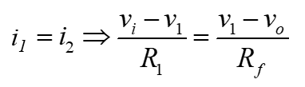
The Inverting Amplifier Circuit
By applying KCL to node 1 of the circuit, one can see that:
Also, in this circuit, the non-inverting terminal is grounded
With negative feedback established through the feedback resistor, this means that v₁ is also zero volts.
This yields:

Slide 26
The Inverting Amplifier Circuit
This can be rearranged to show the relationship between the input and output voltages
From this one can see that:
  The gain is the ratio of the feedback resistor R_{f} and R₁
  The polarity of the output is the reverse of the input, thus the name
  “inverting amplifier”

Slide 27
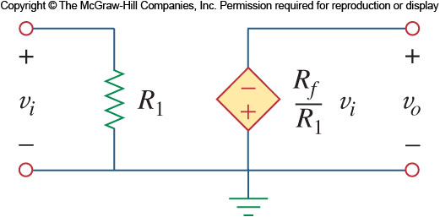
Equivalent Circuit for Inverting Amplifier
The inverting amplifier’s equivalent circuit is shown here
Note that it has a finite input resistance
It is also a good candidate for making a current-to-voltage converter
Notes:
** Current-to-voltage converter: If we consider the amplifying gain Rf / R1 is a constant, then we should consider R1 is a constant. Then, the input voltage vi depends on the current i ( which can be considered as an input variable).

Slide 28
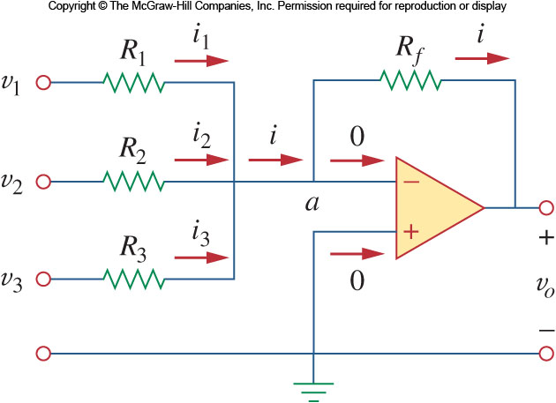



Application Example: Summing Amplifier
Take the inverting amplifier and combines several inputs each via their own resistor:
The current from each input will be proportional to the applied voltage and the input resistance
So we have $v_{o}=−\left(\frac{R_{f}}{R_{1}}v_{1}+\frac{R_{f}}{R_{2}}v_{2}+\frac{R_{f}}{R_{3}}v_{3}\right)$
if $R_{1}=R_{2}=R_{3}=R_{f}$, then we have
$$v_{o}=−\left(v_{1}+v_{2}+v_{3}\right)$$

Slide 29
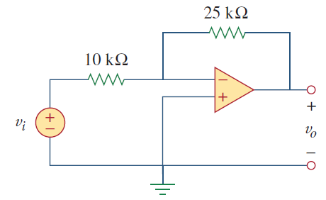
Practice
If v_{i} = 0.5 V, calculate: (a) the output voltage v_{o}, and (b) the current in the 10k resistor.

Slide 30
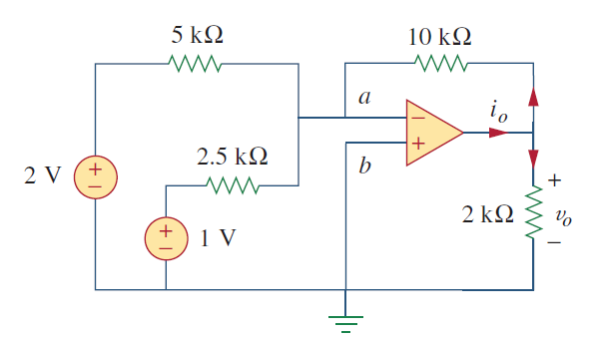
Practice
Calculate v_{o} and i_{o} in the op amp circuit

Slide 31
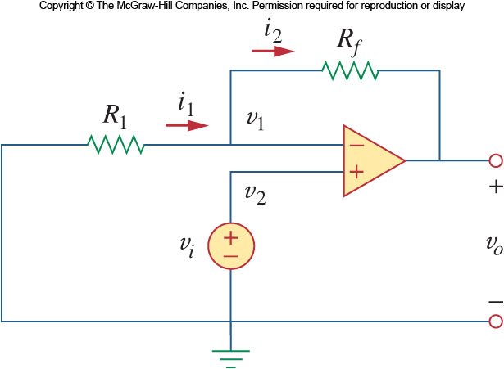
The Noninverting Amplifier Circuit
Another important op-amp circuit is the noninverting amplifier.
The basic configuration of the amplifier is the same as the inverting amplifier.
Except that the input and the ground are switched.
Once again applying KCL to the inverting terminal gives:

Slide 32
The Noninverting Amplifier Circuit
There is once again negative feedback in the circuit, thus we know that the input voltage is present at the inverting terminal.
This gives the following relationship:
The output voltage is thus:
Note that the gain here is positive, thus the amplifier is non-inverting

Slide 33
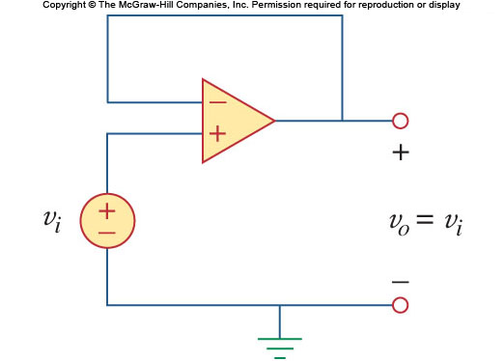
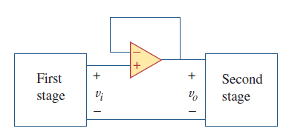
The Noninverting Amplifier Circuit
Note that this amplifier retains the infinite input impedance of the op-amp
One aspect of this amplifier’s gain is that it can never go below 1.
One could replace the feedback resistor with a wire and disconnect the ground and the gain would still be 1.
This configuration is called a voltage follower or a unity gain amplifier.
It is good for separating two circuits while allowing a signal to pass through.

Slide 34
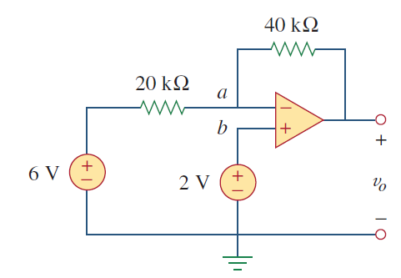
Practice
For the circuit as shown, find the output voltage v_{o} .

Slide 35
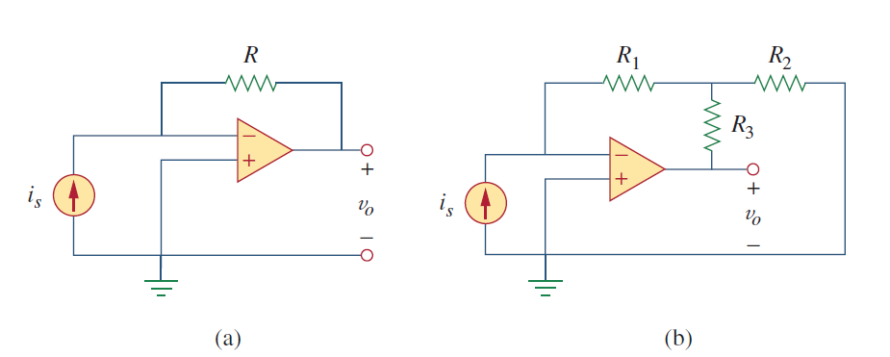
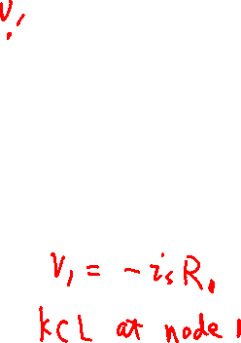
Practice
Find the relation between the output voltage and input current source.

Slide 36
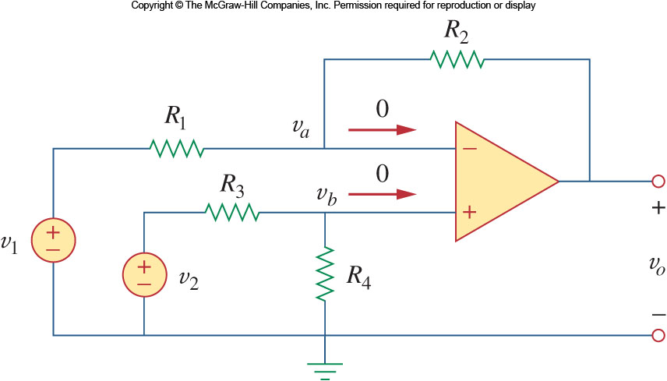

Difference Amplifier
Subtraction should come naturally to the op-amp since its output is proportional to the difference between the two inputs
For a circuit as shown on the right, applying KCL to node a and b in the circuit shown gives:
With the negative feedback present, we know that v_{a}=v_{b} resulting in the following relationship:
$$v_{o}=\frac{R_{4}(R_{1}+R_{2})}{R_{1}(R_{3}+R_{4})}v_{2}−\frac{R_{2}}{R_{1}}v_{1}$$

Slide 37

Common Mode Rejection
It is important that a difference amplifier rejects any signal that is common to the two inputs.
For the given circuit, this is true if:
At which point, the output is:
$$v_{o}=\frac{R_{4}(R_{1}/R_{2}+{1)R}_{2}}{R_{1}(R_{3}/R_{4}+{1)R}_{4}}v_{2}−\frac{R_{2}}{R_{1}}v_{1}$$

Slide 38




Common-mode rejection ratio (CMRR)
An ideal differential amplifier only amplifies the voltage difference between its two inputs. There should be no change in output voltage for any amount of common-mode voltage applied to the inputs.
Ideally,
$$V_{out}=A_{d}(V_{+}−V_{−})$$
In real life, however, this is not easily attained. Thus, common-mode voltages will invariably have some effect on the op-amp’s output voltage. The output of a real differential amplifier is better described as
where A_{cm} is the common-mode gain, that is typically much smaller than the differential gain A_{d}
$$V_{out}=A_{d}\left(V_{+}−V_{−}\right)+\frac{1}{2}A_{cm}(V_{+}+V_{−})$$
$$CMRR=\left(\frac{A_{d}}{{|A}_{cm}|}\right)=20\log_{10}\left(\frac{A_{d}}{{|A}_{cm}|}\right)dB$$
Common-mode rejection ratio (CMRR) is used to describe the ratio of the two gains; it indicates how much of the common-mode signal will appear in your measurement.

Slide 39


Example of Difference Amplifier
Design an op amp circuit with inputs v₁ and v₂ such that
v_{o} = - 5v₁ + 3v₂

Slide 40



Practice
An instrumentation amplifier shown in figure is an amplifier of low level signals used in process control or measurement applications and commercially available in single-package units. Show that
Notes:
Sketch of the solution:
The right part of the circuit is jus the common mode rejector shown on Slide 36. Therefore the output is Vout = (R3 / R2) * (V2’ – V1’), where V1’ is the output voltage from the top left op-amp that takes input V1, and V2’ is the output voltage from the bottom left op-amp that takes input V2.
The left part of the circuit outputs V1’ – V2’ = (V1 – V2)(1 + 2R1/Rg). The trick that the current flowing through R1 and Rgain is the same due to the property of ideal op-amp.

Slide 41

About Instrumentation Amplifier
Instrumentation amplifiers are so useful, they are often packaged as a single chip with the only external component being the gain resistor.
They are very effective at extracting a weak differential signal out of a large common mode signal.

Slide 42



About Voltage Follower
Also known as unity-gain buffer, isolation amplifier…
It is a unity-gain negative feedback op-amp circuit. Thus, it has a gain of one (unity) and does not amplify the incoming signal. The voltage follower does not need any external components.
Then why we need it? Let’s see an example
In this circuit, if R_{o} varies, it will affect the original circuit, V_{out} will change
With the unity gain buffer added, V_{out} will NOT change even if R_{o} varies.

Slide 43

Cascaded Op Amp
A cascade connection is a head-to-tail arrangement of two or more op amp circuits such that the output of one is the input of the next.
Each amplifier is then called a “stage”, the gain of a series of amplifiers is the product of the individual gains:
Op amp circuits have the advantage that they can be cascaded without changing their input-output relationships. This is due to the fact that each (ideal) op amp circuit has infinite input resistance and zero output resistance.

Slide 44

Example
Find v_{o} and i_{o} in the circuit below:

Slide 45

Application Example:
Digital to Analog Converter (DAC)
The summing amplifier can be used to create a simple digital to analog converter (DAC): convert binary values to an analog voltage
  In a digital signal, the input voltage will be either zero which represents ‘0’ or a non-zero voltage which represents ‘1’
  By selecting different input resistors, we can define MSB (most significant bit) and LSB (least significant bit).
  The feedback resistor provides an overall scaling.

Slide 46


DAC Example
Let R_{f} = 10kΩ, R₁=10k Ω, R₂=20k Ω, R₃=40k Ω, and R₄=80k Ω, obtain the analog output for binary inputs [0000], [0001], [0010], . . . , [1111].

Slide 47
Expected learning outcome
Be familiar with the basic characteristics of operational amplifiers, such as
  its equivalent circuit as linear dependent source
  high input resistance, high gain, and low output resistance characteristics
Be able to apply the ideal op-amp concept to analyze several op-amp circuits

